Slide 1
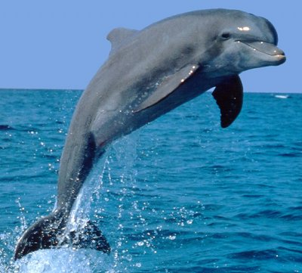
Dolphins
Jack Clancy, Fifth Class.
This Photo by Unknown Author is licensed under CC BY-SA

Slide 2
Dolphin’s habitats
Dolphins are found in temperate and tropical waters around the world.
Though, they inhabit a wide variety of habitats, including harbors, bays, gulfs, and estuaries.

Slide 3
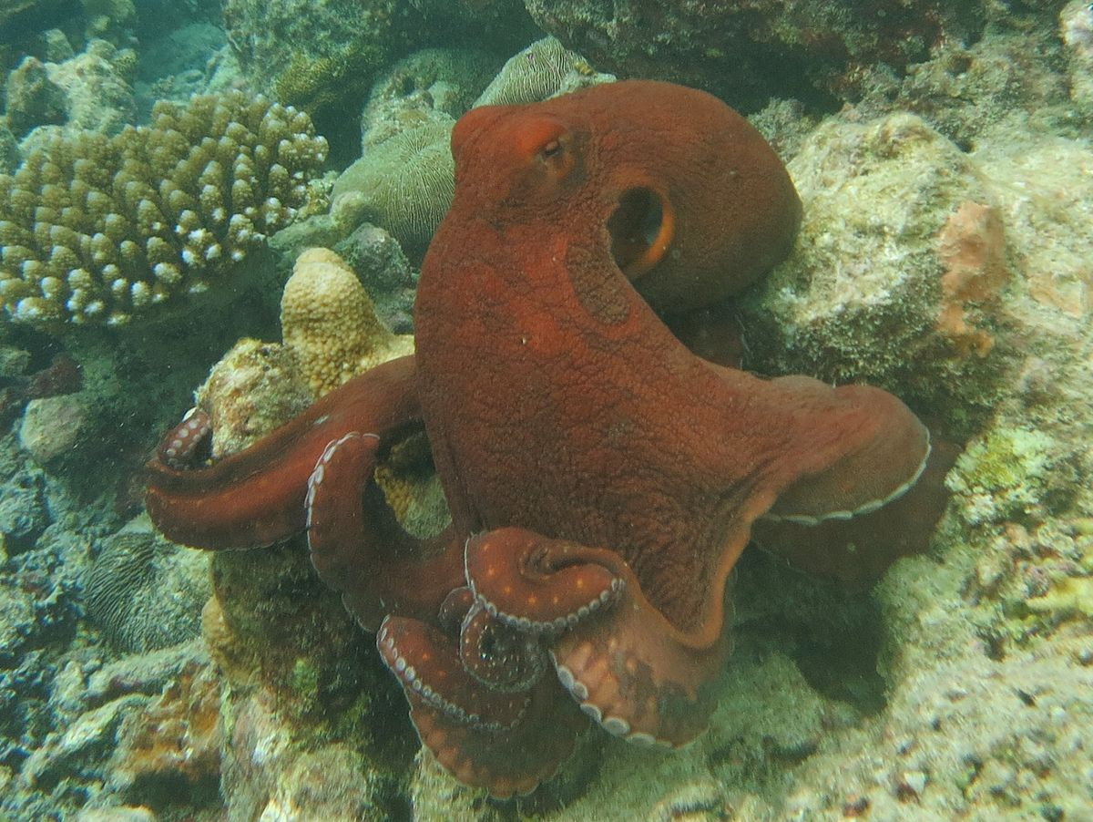
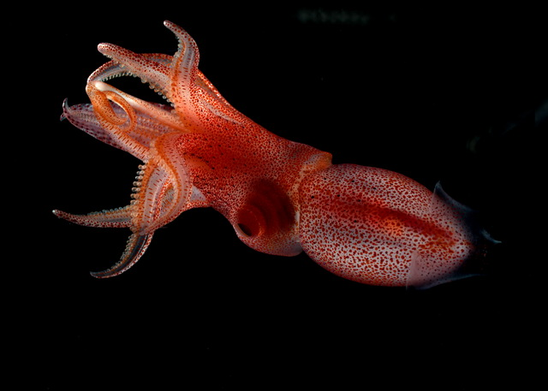
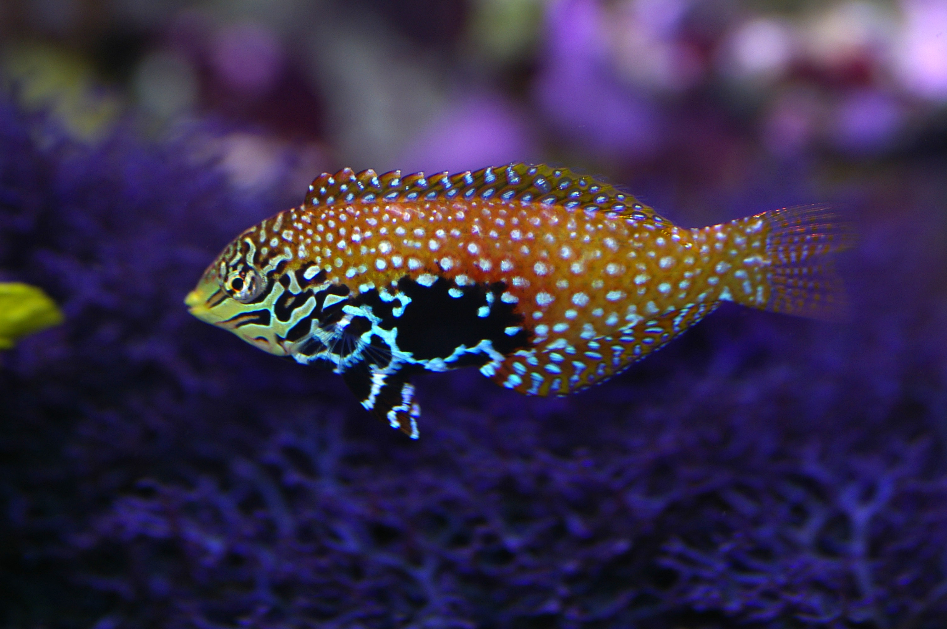
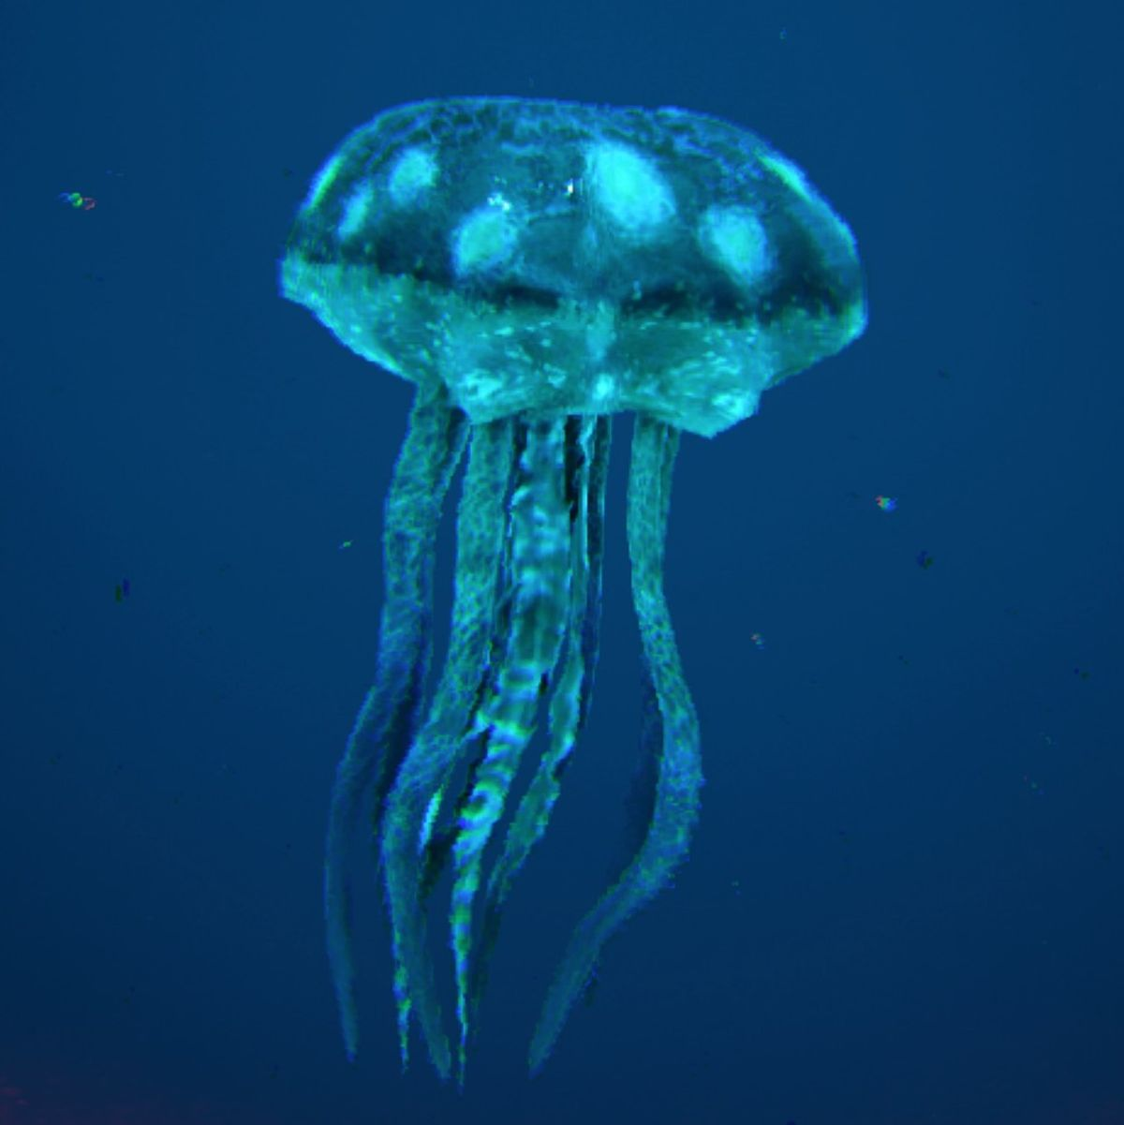
Dolphin’s food
Dolphins are active predators that eat a wide variety of fish.
The animals dolphins eat are squid, fish, jellyfish and octopi.
This Photo by Unknown Author is licensed under CC BY-SA-NC
This Photo by Unknown Author is licensed under CC BY

Slide 4
Predators
Dolphins have few natural enemies and some species or specific populations have none.
The only predators that the smaller species or calves have in the ocean are the larger species of sharks.
Those sharks are the bull shark, dusky shark, tiger shark and the great white shark.

Slide 5
Reproduction of dolphin’s
Dolphins virtually never have twins, they give birth to one baby at a time every 1 to 6 years depending on the species and individuals.
The average time between babies for bottlenose dolphin mothers is 2 to 3 years.

Slide 6
Dolphin’s lifespan
The average dolphin lifespan is in between 30 and 50 years.
If a dolphin was to die of old age now he would have been born before 1980.

Slide 7
A few weird but interesting facts
You would have a hard time sneaking up on a dolphin.
Scientists believe that dolphins give themselves names!
They can also tell you're you.
Male dolphins can be REALLY mean sometimes.
The Killer Whale is actually a dolphin.

Slide 8
THANKS
FOR
WATCHING

