Slide 1
Shortfin mako shark
By Oscar Harman

Slide 2
About the shortfin mako shark
Shortfin Mako sharks are the fastest species of shark. They can
reach speeds up to 74Km/h, These qualities make the shortfin
mako a prized catch among recreational fisherman. Shortfin mako
sharks can accelerate enough to launch themselves 30 foot out of
the water.

Slide 3
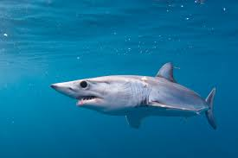
Habitat
This shark species prefers living offshore, in temperate, tropical, or subtropical waters. These creatures live anywhere from the surface to approximately 500 foot deep.

Slide 4
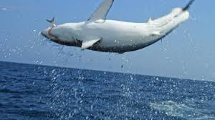
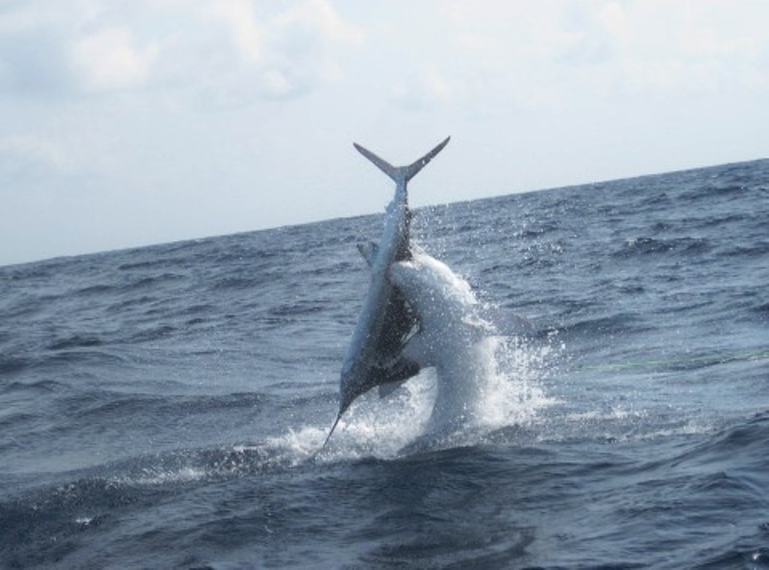
food
This species feeds on a variety of prey. They eat bony fishes and squids but also eat other sharks, small marine mammals, turtles and even sailfish or small marlin.

Slide 5
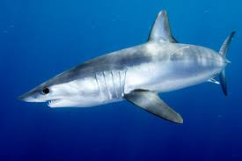
Life span
Shortfin mako sharks live for about 30 years and grow to
about 13 foot and 1300 pounds.

Slide 6
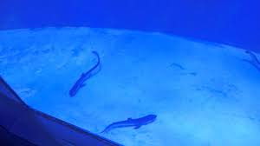
reproduction
Shortfin mako sharks, after a period of 15-18 months give birth to a
small number of relatively large young. The young sharks, called
pups, are born in late winter or early spring. Female mako sharks
give birth to between 4 and 18 pups, and breed every three years.

Slide 7
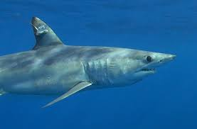
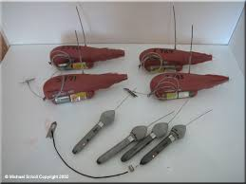
More about the shortfin mako
Shortfin mako sharks are known to be highly migratory, making long
migrations every year. People know this by putting satellite tags on
the sharks dorsal fin.

Slide 8
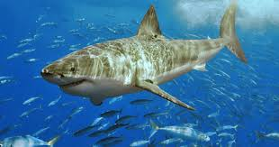
Biggest shortfin mako caught
The largest shortfin mako shark caught was 600kg, caught off the
coast of California on June 3, 2013,and the longest verified length
was 4.45m caught off the Mediterranean coast of France in
September 1973.

Slide 9
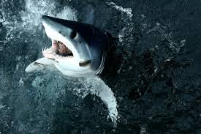
Even more about the shortfin mako shaRK
Shortfin mako sharks were discovered in 1810. Isurus oxyrinchus is the Shortfin mako sharks scientific name. The mako is also sought by commercial fisheries for shark fin soup and is often caught unintentionally as bycatch.

Slide 10
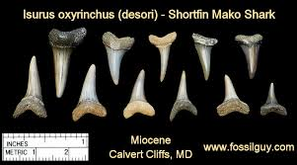
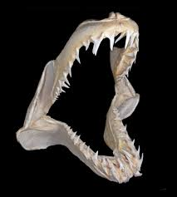
TEETH
    Most sharks have sharp teeth with serrated edges. Teeth are arranged in 12 to 13 rows in the upper jaw and 11 to 12 rows in the lower jaw.

Slide 11
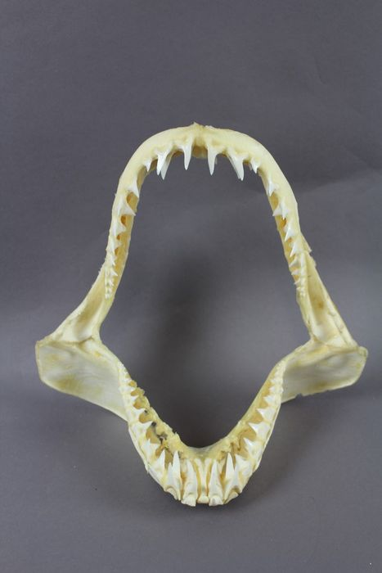
The End

