Slide 1
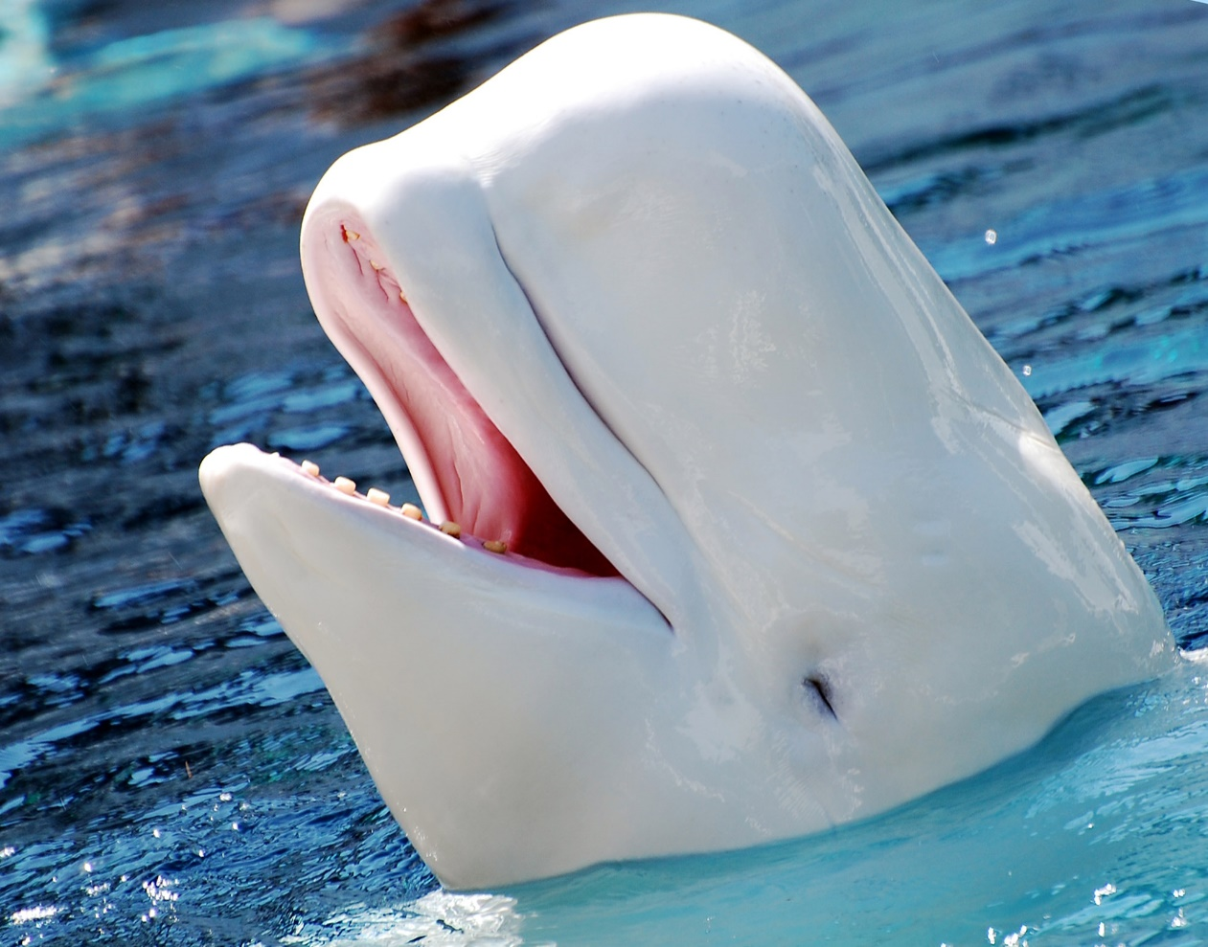
THE BELUGA WHALE By Aaron Currane
COMMON NAME : Beluga Whale
SCIENTIFIC NAME: Delphinapterus Leucas
TYPE : Mammal
GROUP NAME : Pod
AVERAGE LIFE SPAN : 35 to 50 years
SIZE : 13 to 20 feet
WEIGHT : 1 to 1.5 tons

Slide 2
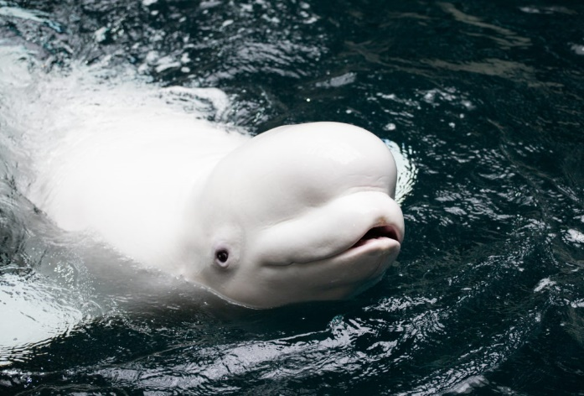
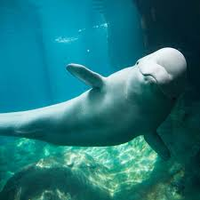
HABITAT
These whales are common in the Arctic Ocean’s coastal waters, though they are found in subarctic waters as well. Arctic belugas migrate southward in large pods when the sea freezes over. They are also found in open ocean, continental shelf, coastal, estuary, and river waters.
FOOD
Beluga whales have a varied diet consisting of octopus, squid, crabs, shrimp, clams, snails and sandworms. They also eat a variety of fishes including salmon, cod, sole, herring, eulachon, smelt and flounder.

Slide 3
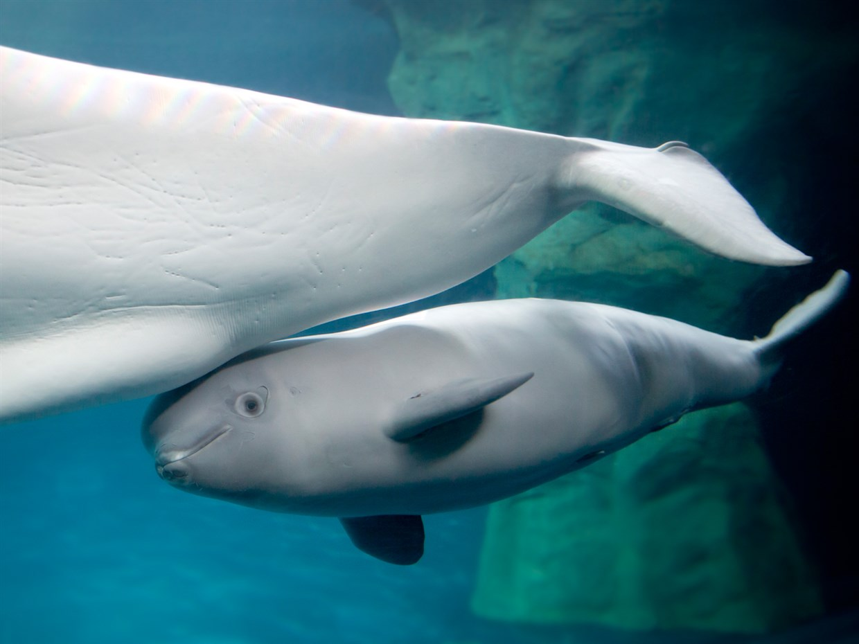
REPRODUCTION
Reproductive cycle is strictly seasonal, though there is slight variability between regions. Observed in human care, gestation ranges from 15 – 16 months. Births occur most often
from late spring to early summer : April- July.
Belugas give birth to one calf at a time. Females give birth every 2-4 years. An average birth lasts eight hours.
Calves may not successfully nurse until more
than a day after birth. Once nursing, belugas
nurse about every half hour, though there may
be variation from calf to calf. Calves curl their
tongue, similar to humans, which is used as a straw for nursing.
When curled a water – tight seal is formed by the scalloped edges around the tongue. A female beluga can lactate ( produce milk ) for approximately 2 years following the birth of her calf. Calves are dependent upon their mother’s milk for the first 6-12 months of life before they begin to eat solid food, but can continue to nurse opportunistically until they are 2 years of age.

Slide 4
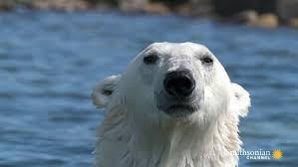
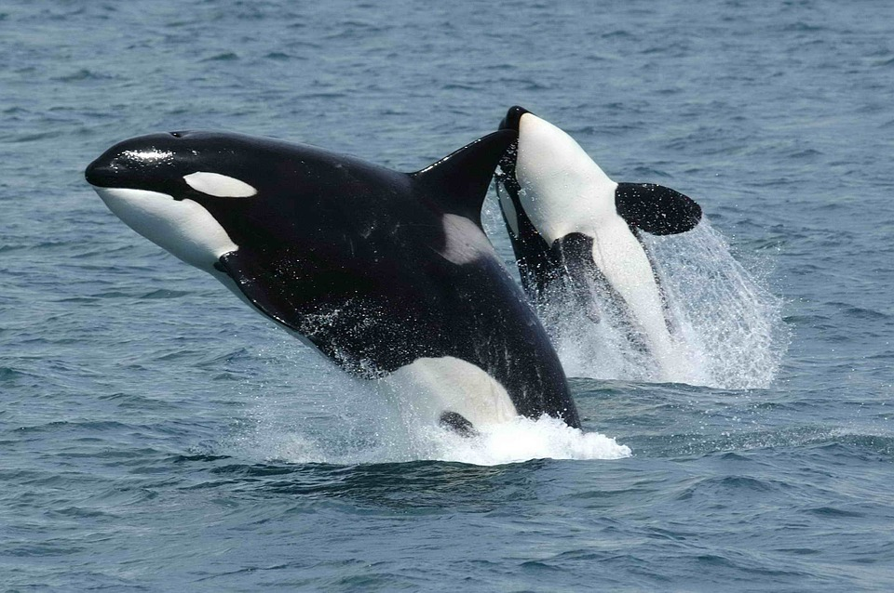
PREDATORS
Polar bears and killer whales are two major predators of beluga whales, although neither of these is considered a significant threat to beluga populations as a whole. Becoming trapped in ice is not uncommon , and groups of belugas large enough to have an effect on the population can become restricted to small areas by shifting sea ice. Climate change resulting in less ice in northern waters could potentially lead to increased fishing and sea traffic, which could threaten belugas with higher levels of pollution , decreased prey and environmental disturbances.

Slide 5
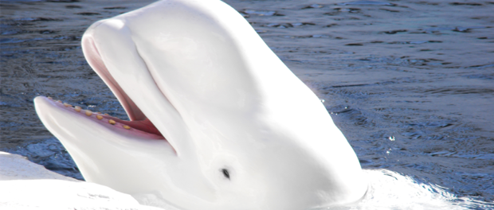
INTERESTING FACTS
The vertebrae in a beluga’s neck are not fused together, giving it the unusual ability to turn it’s head up, down and side-to-side.
The beluga whale can change the shape of it’s bulbous forehead, called a “melon”, by blowing air around it’s sinuses.
The beluga whale can swim backwards. This adaption is helpful in an environment where sea ice can change rapidly.
Beluga whales dives may last up to 25 minutes and can reach depths of 800 meters.
Also known as “sea canaries”, belugas are one of the most vocal of all whales.

